Slide 1

RoadReady Driving App
STOP
Group
Arvind Rawat | Matthew Mahon
20368773 | 20410582
Project Advisor
Hossein Javidnia
Notes:
Hello, My name is Arvind, and this is Matthew.
Our project advisor for our final year project is Hossein.

Slide 2


Introduction
Developed the driving test preparation mobile app “RoadReady” to simplify the journey from a learner to licensed driver.
App offers an intuitive platform for learning the rules and regulations of the road as well as allowing users to prepare for their theory test.
Developed with a focus on user experience, RoadReady equips learners with the tools needed for a successful test completion while instilling safe driving habits for life.
RoadReady
Driving App
Notes:
We have developed the driving test preparation mobile app called “RoadReady” which simplifies the journey for a learner to become a licensed driver. Our app offers an intuitive platform for learning the rules and regulations of the road as well as allowing users to prepare for their theory test.
We have developed the app with a focus on user experience, to ensure they successfully pass their theory test, while instilling safe driving habits for life.

Slide 3
Problem
Statement
High Failure Rates
Overall average driving pass rate is 53%
Comprehensive learning
Existing apps offer either theory or practical driving assistance, not both.
Limited Practice Resources
Lack of access to practice routes
Long Waiting Times
Leaner drivers facing long wait times for both theory/practical test
Notes:
Before deciding on the app, we discussed some problems learners face during their driving test and theory test preparation. We mainly did this by asking a handful of students from our class. Our findings were:
High Failure Rates: With an overall average driving test pass rate of 53.2%, many learners require multiple attempts to pass, indicating a need for more comprehensive preparation tools.
Limited Practice Resources: Learners lack access to practice routes and real-time navigation for their local test centres, which are crucial for practical test preparation.
Comprehensive Learning Approach: Existing apps offer either theory or practical driving assistance, not both, leaving a gap for an all-in-one solution.
Long Waiting Times: Learner drivers often face long waiting times for both theory and practical driving tests, leading to delays in obtaining a license.

Slide 4
Solution Overview
Integrated Learning
RoadReady combines theory test preparation with practical driving tools, offering an all-in-one platform
Real-Time Navigation
The upcoming live navigation feature will allow learners to practice on actual test routes, providing a realistic experience
Comprehensive Content
Vast database of practice questions, mock exams, and real-time navigation
Efficiency and Convenience
RoadReady minimizes the impact of long waiting times, allowing learners to make the most of their preparation period.
Notes:
To solve the issues learners face during the preparation for their driving and theory test we propose the following:
Integrated Learning: RoadReady combines theory test preparation with practical driving tools, offering an all-in-one platform that caters to both aspects of driver education.
Comprehensive Content: With a vast database of practice questions, mock exams, and real-time navigation, our app ensures learners are thoroughly prepared, aiming to increase the driving test pass rate.
Real-Time Navigation: The upcoming live navigation feature will allow learners to practice on actual test routes, providing a realistic experience and reducing the need for repeated practical tests.
Efficiency and Convenience: By facilitating at-home study and route practice, RoadReady minimizes the impact of long waiting times, allowing learners to make the most of their preparation period. RoadReady not only fills the current market gap but also empowers learners with the knowledge and confidence needed to pass their driving tests and become safe, responsible drivers.

Slide 5
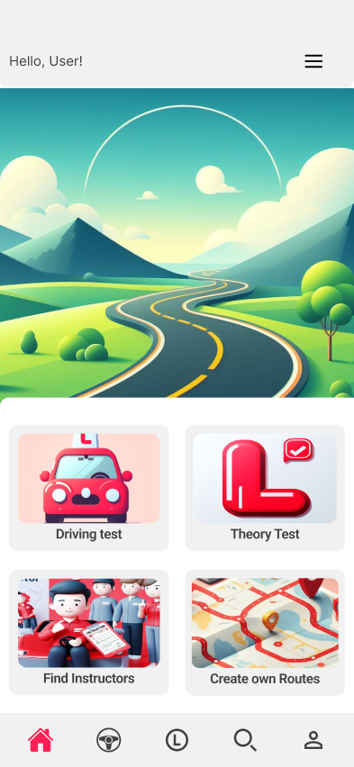
App’s Main Features
1
2
Theory Test
Performance Tracking
The core feature that offers a comprehensive set of practice questions and mock exams to help users prepare for the theory test.
records users’ scores and progress over time, providing insights into their strengths and areas for improvement.
3
4
User Profile Management
Educational Resources
Allows users to create and manage their profiles, including updating personal details and managing account settings.
Direct links to official RSA resources and guidelines, ensuring users have access to accurate and current information.
Notes:
the current functionality we have in our app is as follows:
Theory Test Preparation: The core feature that offers a comprehensive set of practice questions and mock exams to help users prepare for the theory test.
Performance Tracking: A feature that records users’ scores and progress over time, providing insights into their strengths and areas for improvement.
User Profile Management: Allows users to create and manage their profiles, including updating personal details and managing account settings.
Educational Resources: Direct links to official RSA resources and guidelines, ensuring users have access to accurate and current information.

Slide 6
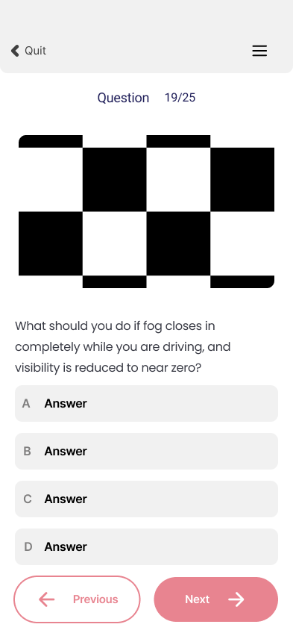
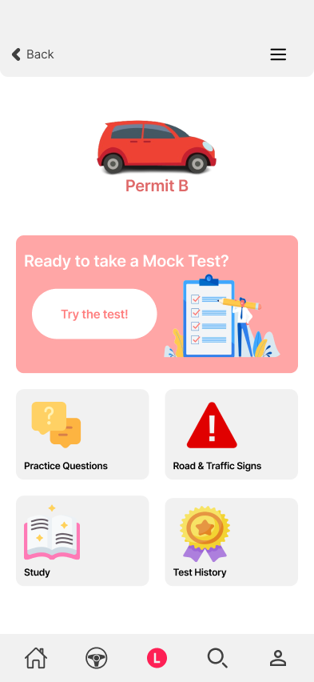
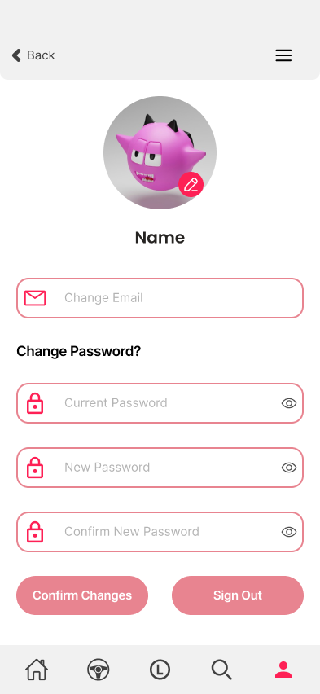
User Interface
& Experience
Followed the design techniques from “UI design and Implementation” module from 3rd year:
Notes:
We followed the design techniques from “UI design and Implementation” module from 3rd year:
We were consistent with our design, ensuring the UI elements like buttons, fonts and colour styles were consistent across all screens. This consistency helps users become familiar with the app’s interface.
We used simple and natural dialogue by concentrating on delivering content with the least amount of user effort, avoiding complex instructions, words etc.
We provide informative feedback for each action the user performs
The app reduces user’s memory load as they don’t have to remember information from one area of the app to get to another area. E.g the app can be navigated from both the side menu and bottom navigation.
We provided shortcuts for frequent use. For example, we made it easy for a user to sign out from the side menu instead of the user having to go to the profile page.
The error messages are displayed clearly for example when a user types in an incorrect password they get a popup saying invalid email/password.
Potential user errors are avoided as our app includes confirm actions for example when quitting the theory test, they are prompted with a confirmation pop-up.
Lastly, users can easily undo actions for example in practice tests, users can change their answers before submitting.

Slide 7




Technology Stack
Outline the technologies and tools used in app development:
React Native – Frontend development and UI
OpenStreetMap – To create Routes
Firebase – Database, Database Management, and Authentication
Expo Go – Testing, Emulating, and to allow for quick development
Prototype delivery:
Learning Material
Theory Questionnaire
Driving Test Routes

Slide 8
Development Journey
Development Journey:
Share the process, challenges, and solutions encountered during development

Slide 9
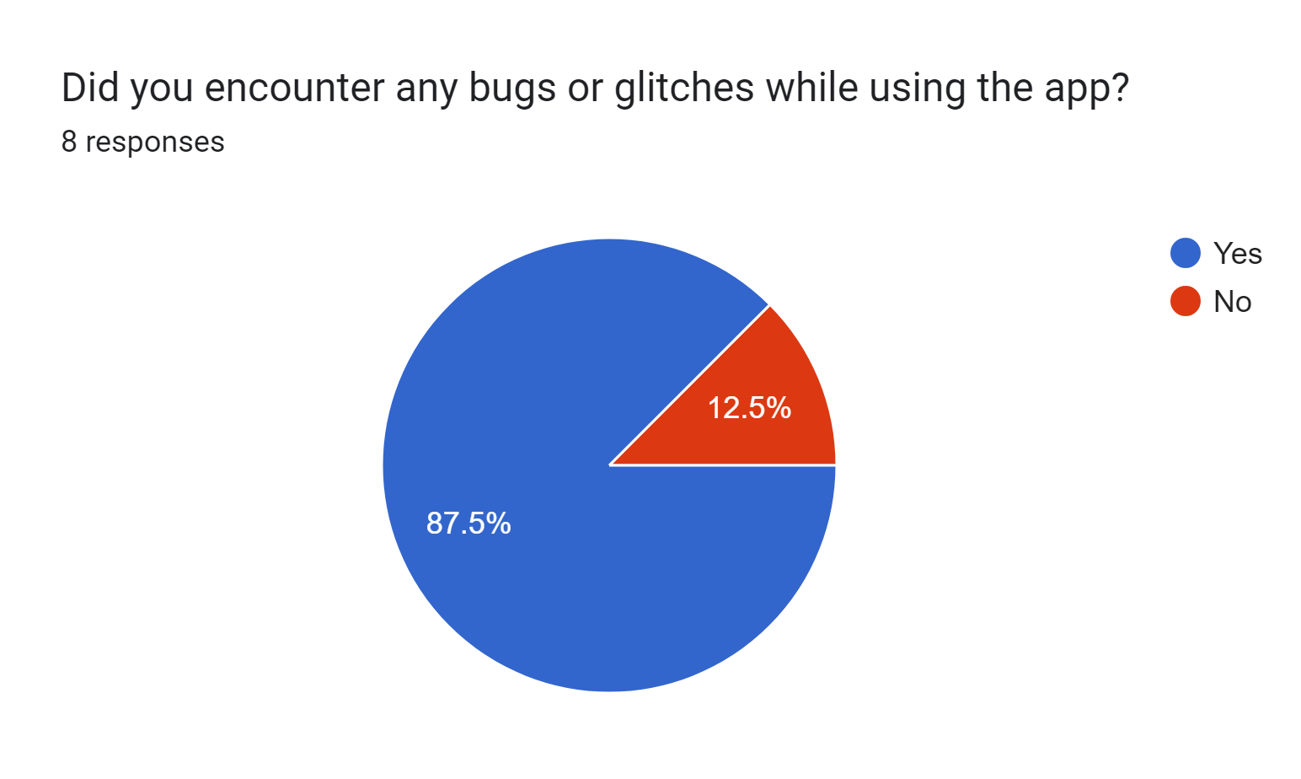
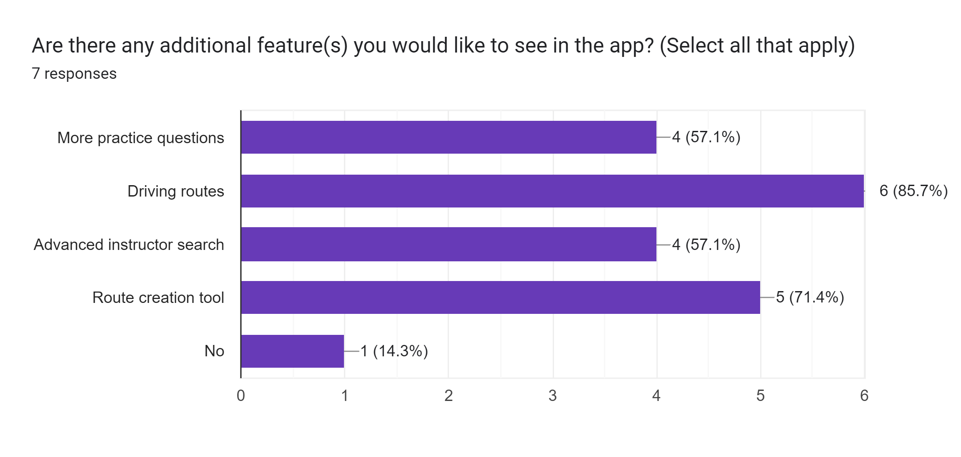
Testing & User Feedback
Testing
Users were asked to test the app.
Bugs were found and fixed.
Corrections were made to existing features.
User Feedback
We then asked Users to give feedback on:
Potential Improvements
Additional Features
Their overall experience with the app.

Slide 10
Business Model & Marketing
Subscription Price List
Basic Plan
Premium Plan (monthly)
Premium Plan (Yearly)
Core features for individual users
Email support
All features, including advanced functionalities
Priority email and chat support
All features, including advanced functionalities
Priority email and chat support
FREE
€4/month
€48/year

Slide 11
Future Roadmap
Feature Completions
Driving Test Routes
Route Creation (MapBox)
Instructor Finder
Feature Improvements
Learning Materials
Profile Customisation
Progress Tracking
Upcoming Features
Instructor Rating
Route Sharing
Route Rating

Slide 12
Closing Thoughts
subheading
Summarize the app’s impact and invite the audience to explore it further.

Slide 13
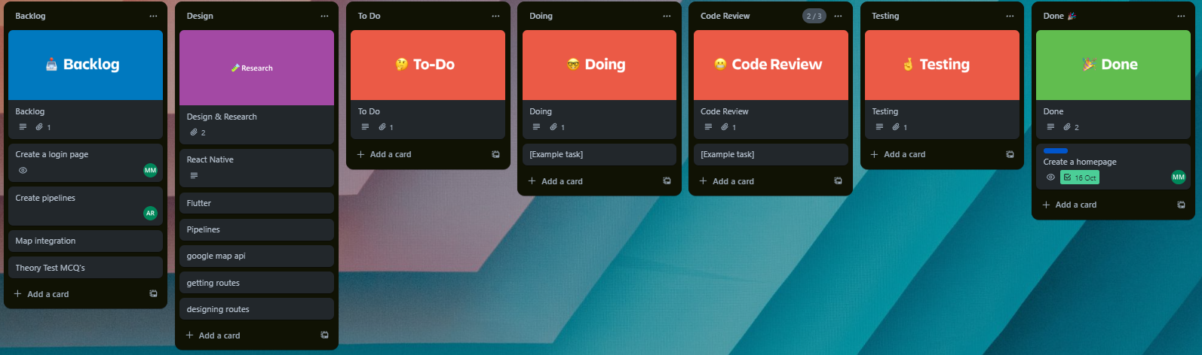
EXTRA
Proposed Timeline of Activities
Trello Board:
Create Tasks
Assign Tasks
Update development activity of tasks

Slide 14
References
EXTRA
[1] Murphy, E. (2023). Over 1,700 drivers in Ireland operating on learner permits for over 30 years. [online] Irish Mirror.Available at: https://www.irishmirror.ie/news/irish-news/shock-over-1700-drivers-ireland-30399907;
White, J. (2023). Almost 60,000 learner drivers face 10-month wait for tests. [online] Irish Examiner. Available at: https://www.irishexaminer.com/news/arid-41133487.html [Accessed 17 Oct. 2023].
[2] RSA.ie. (n.d.). Education - Road safety awards. [online] Available at: https://www.rsa.ie/road-safety/statistics [Accessed 17 Oct. 2023].
[3] www.cso.ie. (n.d.). Driver and Vehicle Testing - CSO - Central Statistics Office. [online] Available at: https://www.cso.ie/en/releasesandpublications/ep/p-tranom/to2016/dvt/#:~:text=A%20total%20of%202%2C820%2C528%20Irish [Accessed 19 Oct. 2023].
[4] White, J. (2023) One year to cut driving test wait times to 10 weeks, Irish Examiner. Available at: https://www.irishexaminer.com/news/arid-41114116.html [Accessed: 24 October 2023]
React Native. [online] Available at: https://reactnative.dev [Accessed 19 Oct. 2023].
OpenStreetMap Contributors (2019). OpenStreetMap. [online] OpenStreetMap. Available at: https://www.openstreetmap.org [Accessed 19 Oct. 2023]
Google (2019). Firebase. [online] Firebase. Available at: https://firebase.google.com [Accessed 19 Oct. 2023].
Expo. (n.d.). Expo. [online] Available at: https://expo.dev/client [Accessed 19 Oct. 2023].

